Slide 1
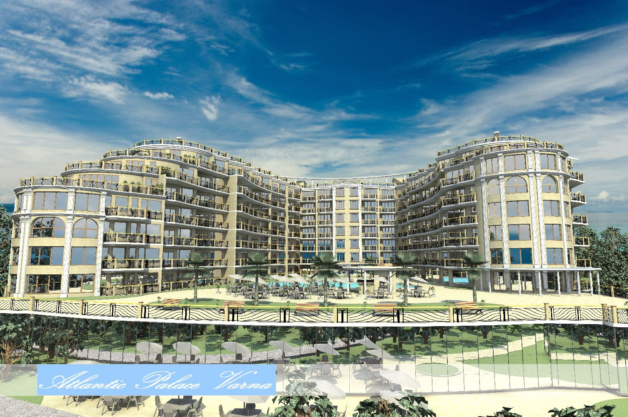
COMPLEX Atlantic Palace, Varna

Slide 2
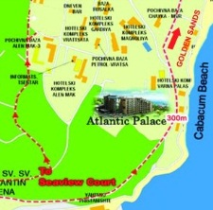
LOCATION
ATLANTIC PALACE Hotel Complex with Luxury Apartments, five-star category, which is currently under construction, is located in the continent: Europe, country: Bulgaria, town: Varna, in the region between two sea resorts known worldwide: Golden Sands resort and Sts. Constantine and Helen resort. The locality of the complex is unique – it is 200 meters away from the sea shore and 60 m above the seal level – place where you can take delight in the entire sea view from Albena resort to Varna. In close proximity to the complex is located the Golden Sands National Natural Park, which is a preserved area. The beaches that stand closest to the complex are 200 - 400 meters away, named the Kabakum Beach and the Sunny Day Beach. On these beaches you can find the newest yacht port, which is used by the visitors of the hotels and the owners of luxury housings within the region. A chair lift is situated in close proximity which facilitates the transport to the beach line.
Here the sea is crystal clear and the length of the beach line is about 2 000 meters – it is covered with fine quartz sand. The holiday season starts as soon as the beginning of May and continues to October. The air temperatures during the summer season are between 25° and 35°C and those of the water - 24°-26°C.

Slide 3
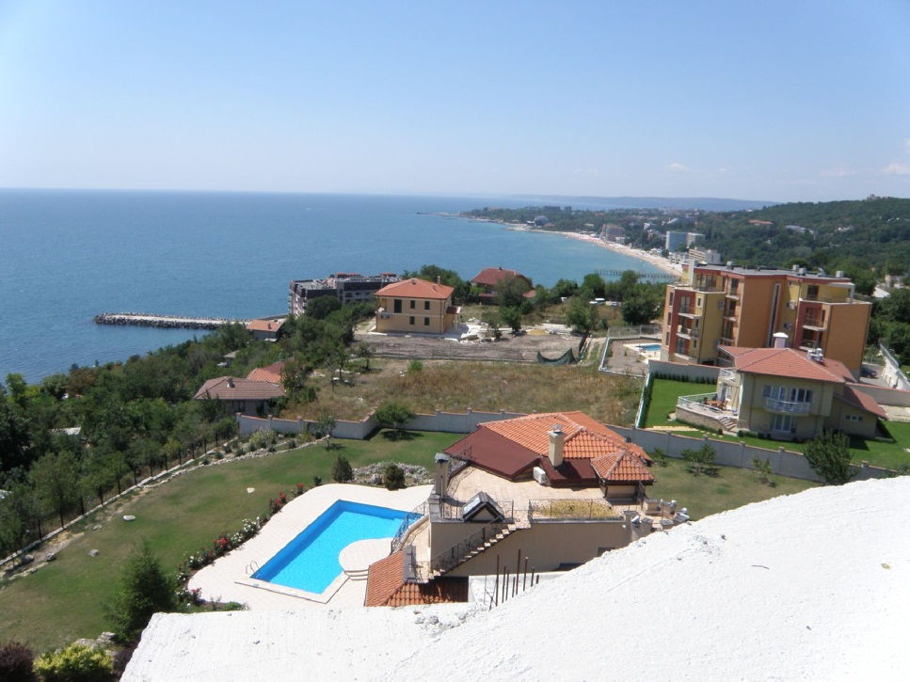
DISTANCE TO IMPORTANT SITES
International airport: Downtown Internationally famous Bulgarian sea resorts Beach line yacht port chair lift golf course Golden Sands National nature Park | Varna – 20km, Burgas – 120km, Sofia - 450km Varna–6km,Burgas–120km,Sofia–450km,Plovdiv-400km Golden Sands – 3 km, Sts. Constantine and Helen – 1 km, Albena – 17 km 200 m 500 m 130 m Town of Kavarna, 18 holes – 70 km 2 km

Slide 4
PROJECT DESCRIPTION
The aim of the project is to build a modern complex – five stars, designed to combine a variety of functions related to recreation, tourism and business.
The complex consists of three independent six-floor bodies, interconnected by means of a covered connection on the level of basement and ground floor. BUILDING 1 - a hotel /75 double rooms – five-star category, with unfolded built-up area of 8006 sq.m./ and BUILDING 2 and BUILDING 3 – a residential section /116 apartments, one or two bedrooms, with an area of 70 to 130 sq.m. / with unfolded built-up area of BUILDING 2 being 2 686 sq.m. and that of BUILDING 3 – 8798 sq.m.. The total area of the plot, where the buildings are situated is 10 000 sq.m. and they have a common infrastructure. The investor’s idea is a full range of services provided by the hotel, which will be used by the owners. This will be a guarantee for higher standard of living and for higher degree of return of the investment made by the housings’ owners, because of an opportunity for profitability from hotel area rather then from residential area is provided.

Slide 5
Services provided within the complex
The services provided within the complex, which is currently under construction, will be the following:
-Casino
-Several restaurants offering national and European cuisine
-Rehabilitation and recreation services:
* SPA centre /supply with medicinal hot mineral water/
* indoor and outdoor swimming pool
* fitness centre
-Conference halls for seminars
-Controlled access to the residential section of the complex
-Sport facilities
-Wine-cellar where you can taste the best Bulgarian wines
-Commercial establishments – shops, etc.
-bank office
-medical services
-parking

Slide 6
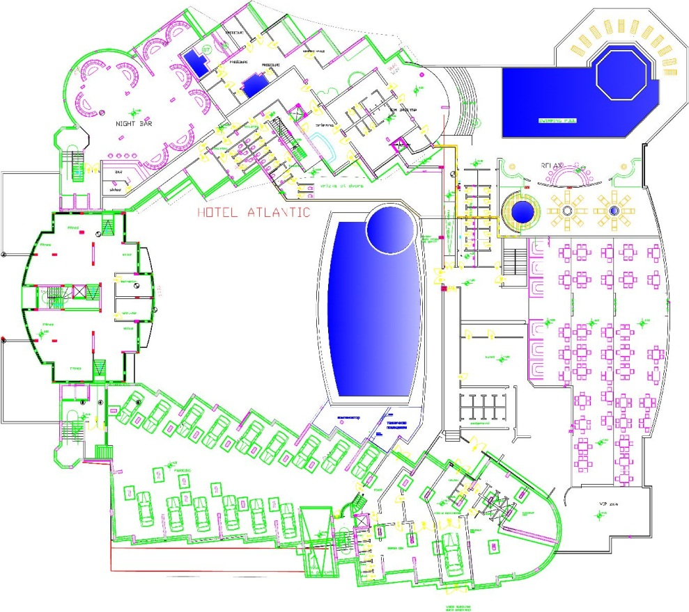
BASEMENT

Slide 7
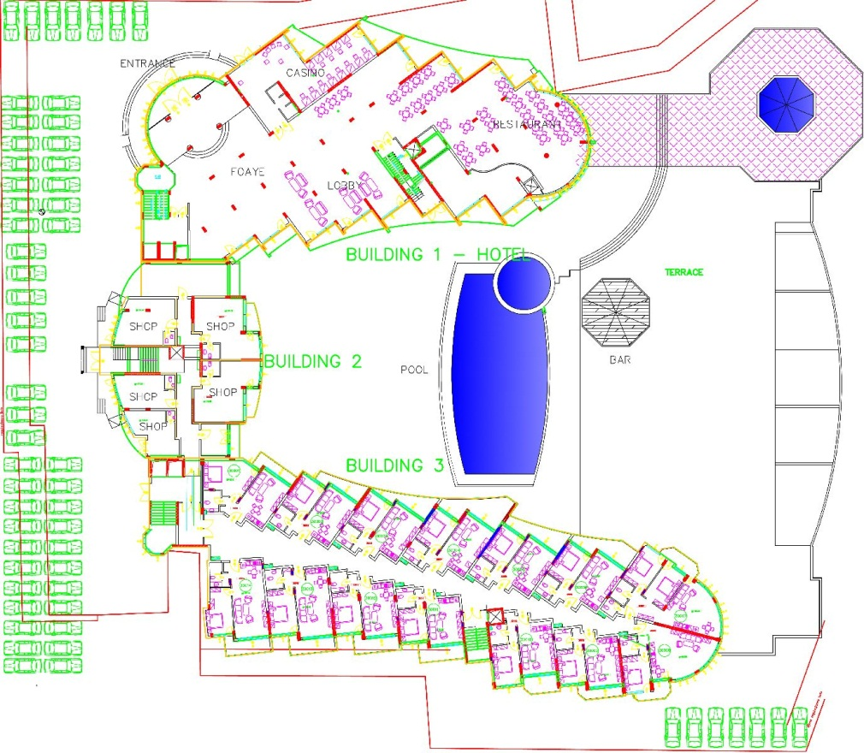
PARTER

Slide 8
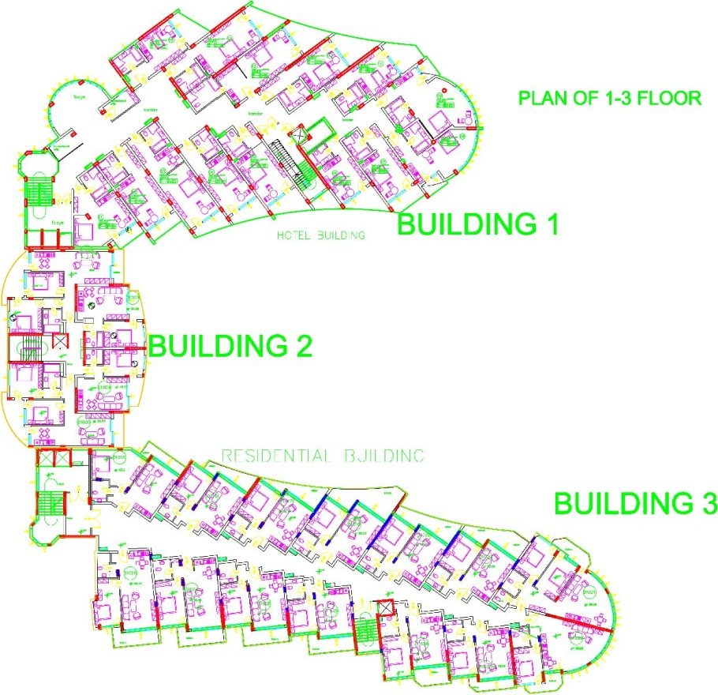
PLAN OF BASIC FLOOR

Slide 9
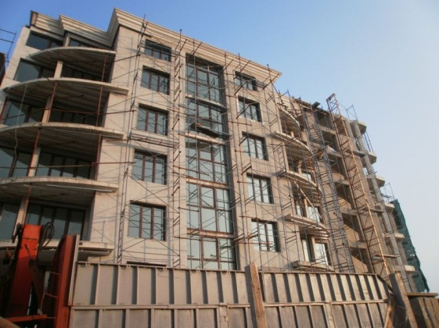
LEVEL OF COMPLETITION
Section 2 and 3 /residential parts/ are finished to shell stage, together with all installations; it is now being worked on the finishing works.
Section 1 – hotel built to shell stage to the third floor.
The complex could be finished by the end of 2012.

Slide 10
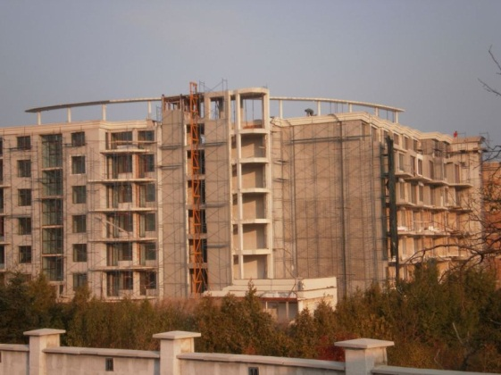
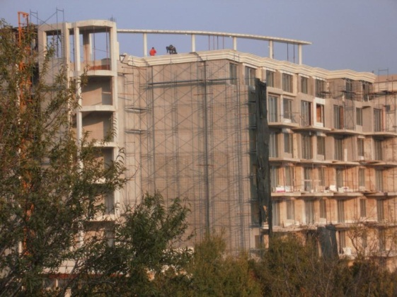
LEVEL OF COMPLETITION

Slide 11
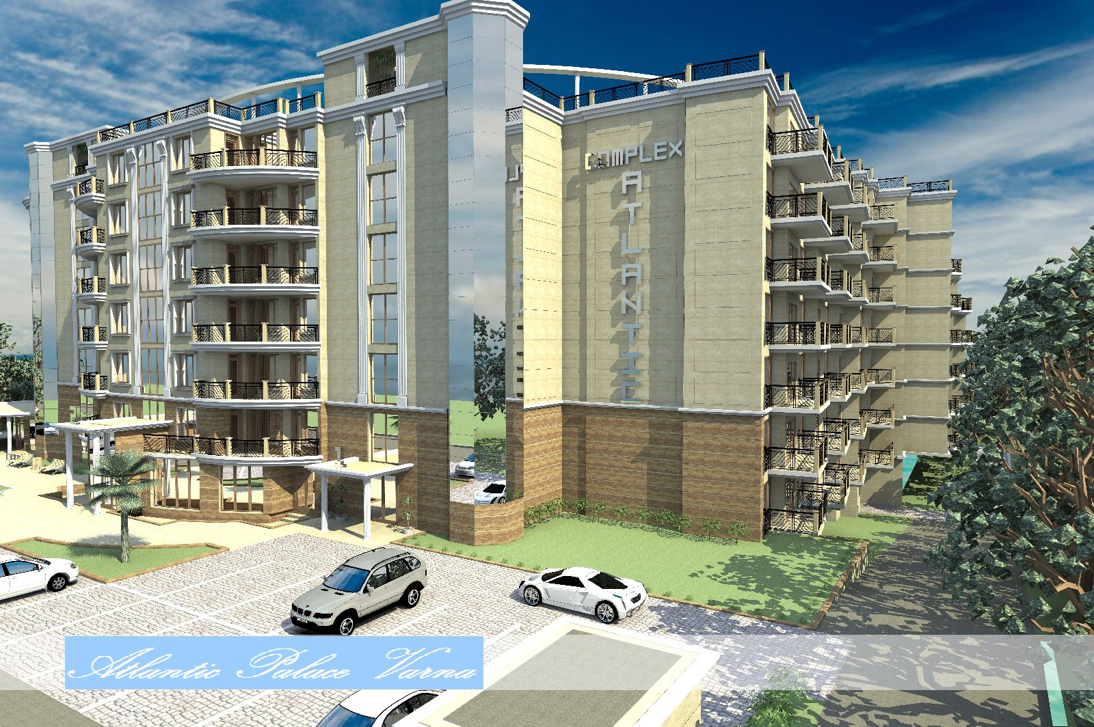
GALLERY

Slide 12
INNER COURT

Slide 13
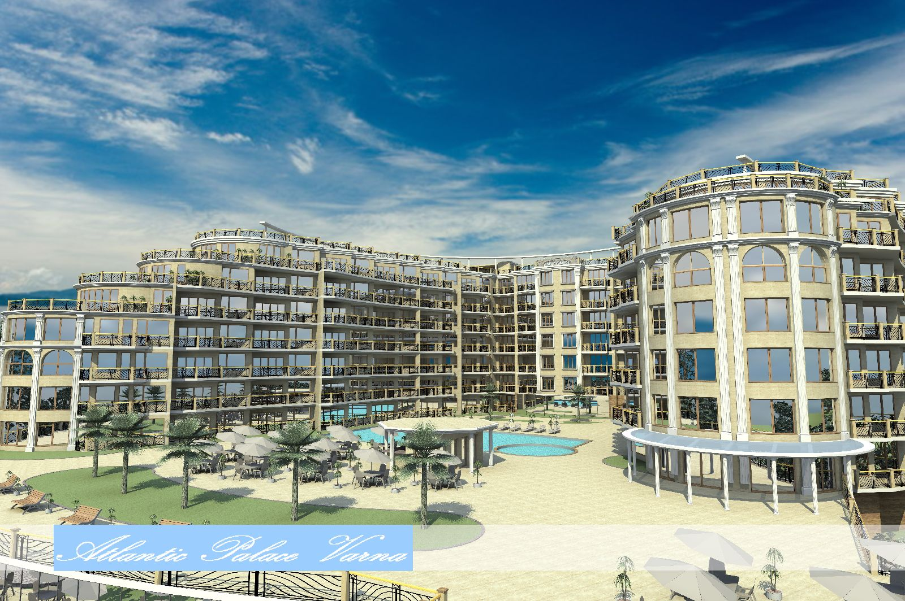
INNER COURT

Slide 14
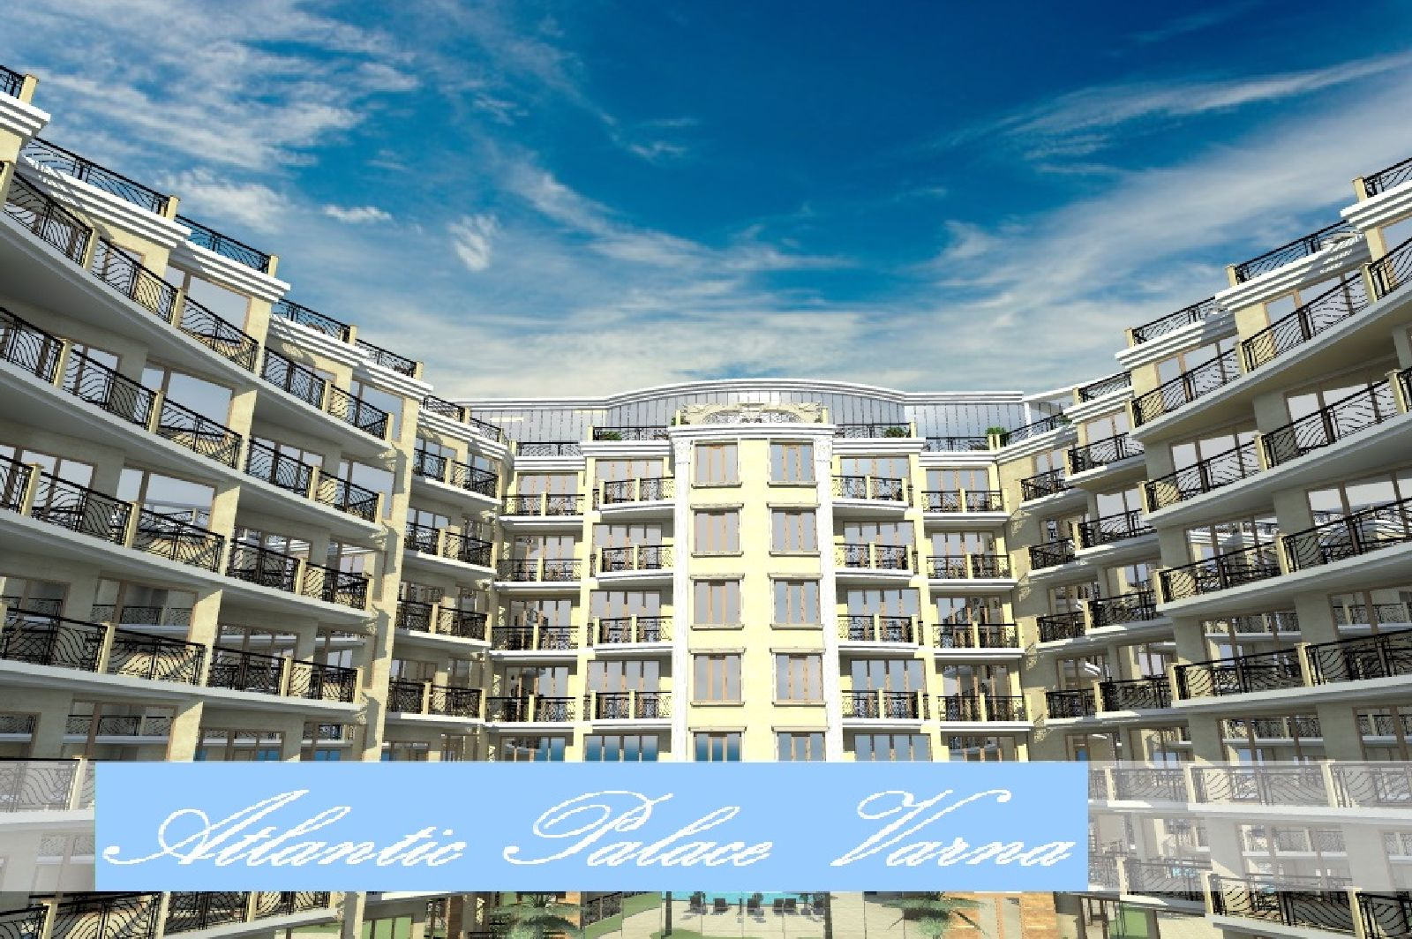
INNER COURT

Slide 15
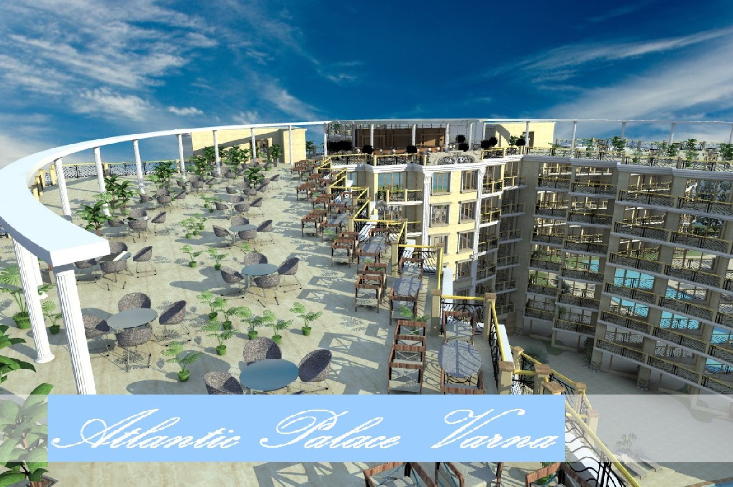
ROOF BAR

Slide 16
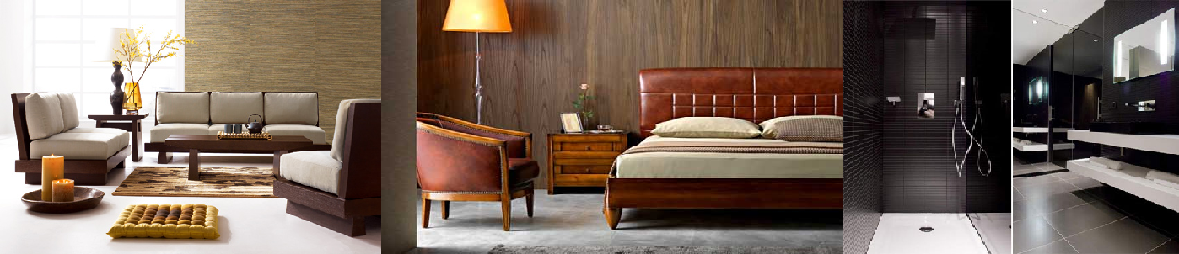
INTERIORS

Slide 17
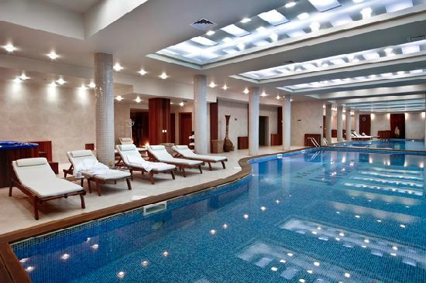
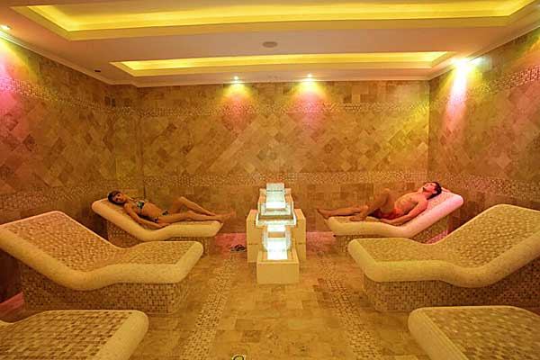
SPA CENTER

Slide 18
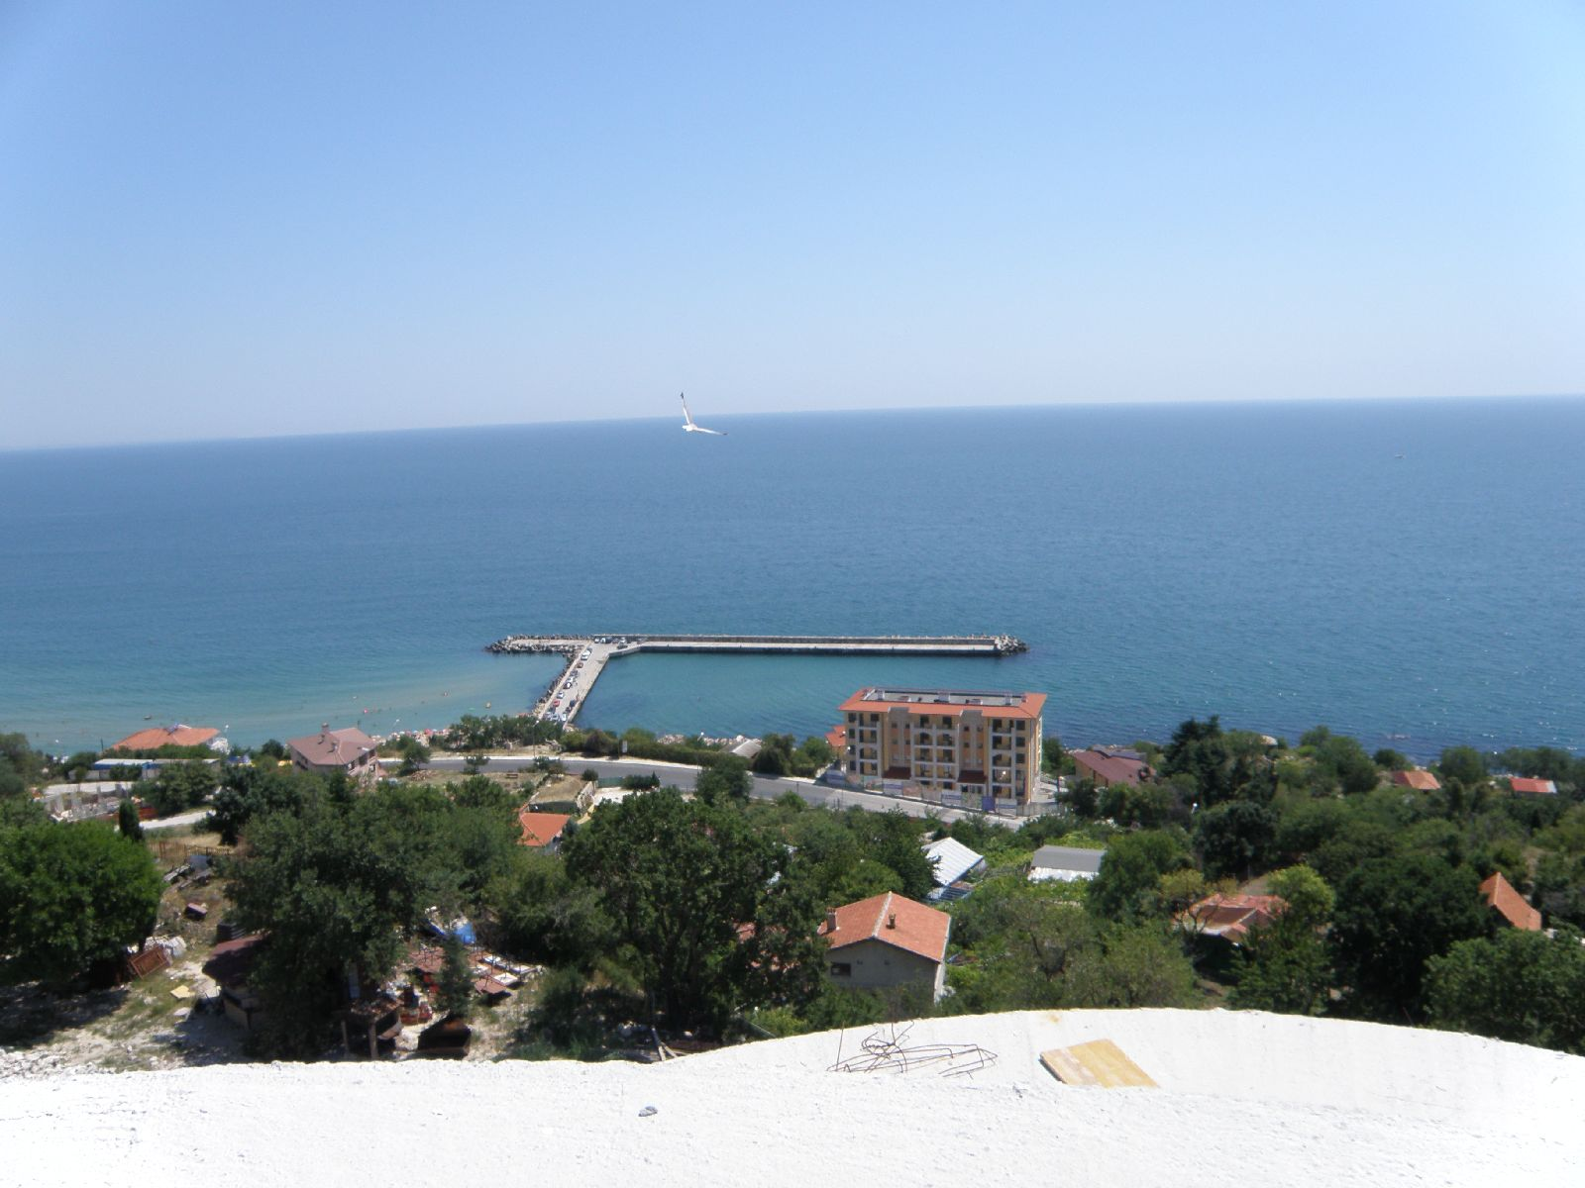
VIEW FROM THE COMPLEX

Slide 19

VIEW FROM THE COMPLEX

Slide 20
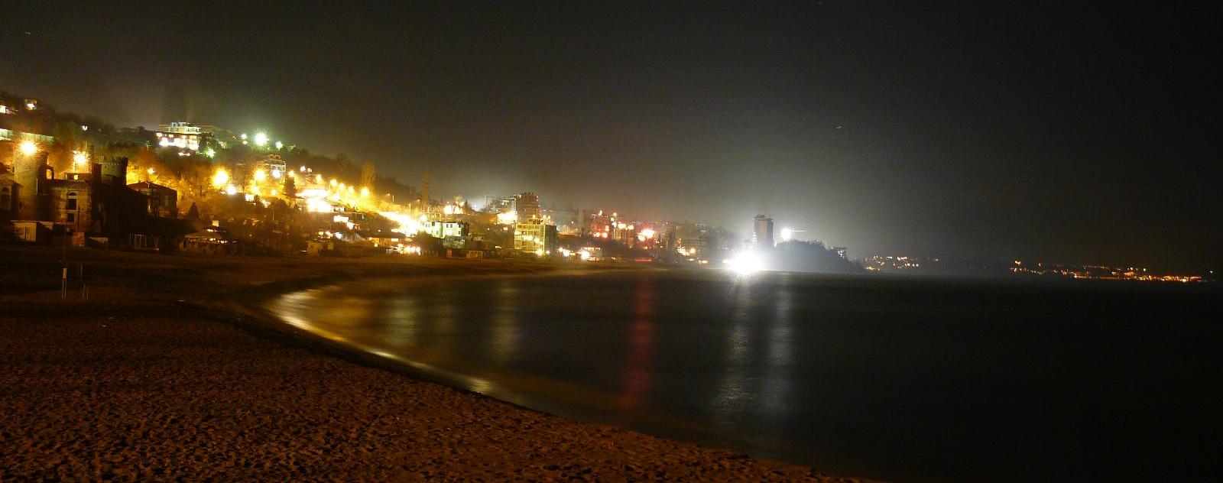
KABAKUM BEACH

